Slide 1

SHREE RAMSWAROOP MEMORIAL UNIVERSITY
Assignment:-11
Java Enterprise Edition Lab - 11
Submitted to:
Submitted by:
Vidushi Srivastava
Mukesh Prajapati
Btech (Cse Industry integrated)
Roll No – 202410101230007

Slide 2
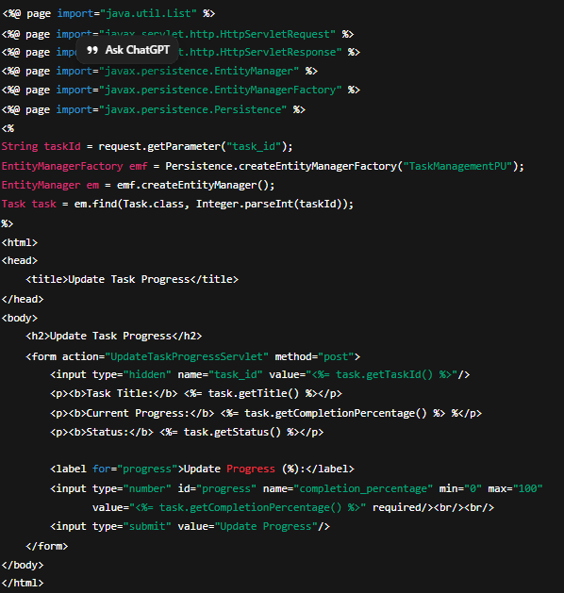
1. Design Progress Update Form (JSP Page)
This JSP page allows users to view and update the progress of a specific task.

Slide 3
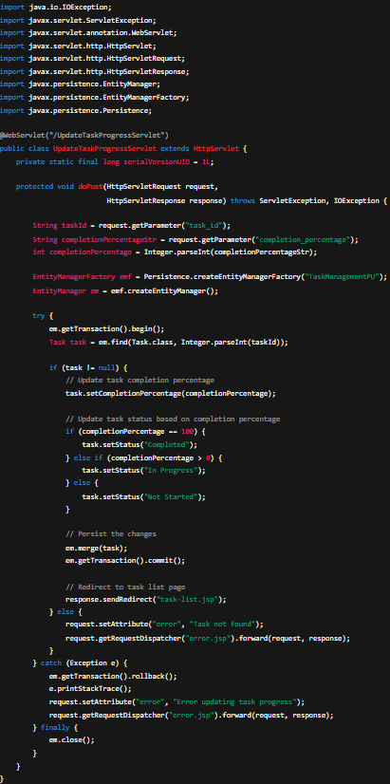
2. Develop Progress Tracking Servlet
This servlet processes the progress update form submission, updates the task’s completion percentage, and sets the new status accordingly.

Slide 4
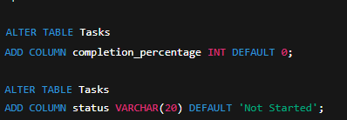
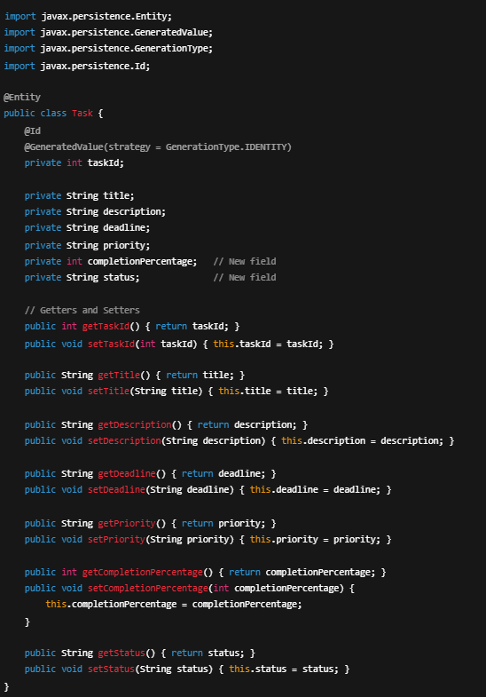
3. Update Database Schema
Ensure the database table includes columns for tracking progress and status.
4. Modify JPA Entity (Task.java)
Update the Task entity class to include new fields for completion percentage and status.

Slide 5
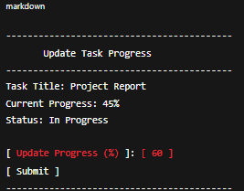


Output / Expected Result
Browser View:
  The JSP displays task title, current progress, and status.
  A numeric input allows users to enter progress (0–100%).
  Upon submission:
    Status changes automatically:
      0% → Not Started
      1–99% → In Progress
      100% → Completed
    Data is saved to the database via JPA.
    Redirects to the task list page.
Example UI (Simulation):
After submission:
When updated to 100%:

